Slide 1
ListView nâng cao

Slide 2
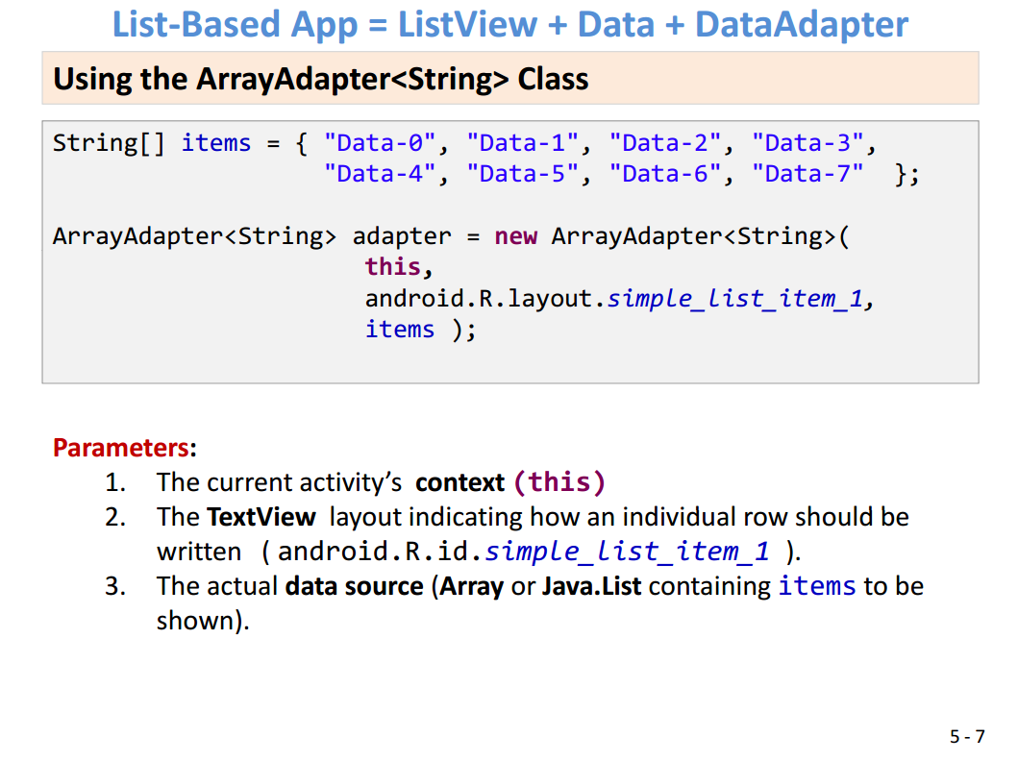

Slide 3
Tùy biến ListView (Web & Location)
Tạo lớp định nghĩa dữ liệu cho ListItem
public class ItemsList { private String foodName, foodLink, foodLocation; private int foodImage; public ItemsList() {} public ItemsList(String foodName, String foodLink, int foodImage, String foodLocation) { this.foodName = foodName; this.foodLink = foodLink; this.foodImage = foodImage; this.foodLocation = foodLocation; } public String getFoodName() { return foodName; } public String getFoodLink() { return foodLink; } public String getFoodLocation() { return foodLocation; } public int getFoodImage() { return foodImage; } public void setFoodImage(int foodImage) { this.foodImage = foodImage; } public void setFoodName(String foodName) { this.foodName = foodName; } public void setFoodLink(String foodLink) { this.foodLink = foodLink; } public void setFoodLocation(String foodLocation) { this.foodLocation = foodLocation; } }

Slide 4
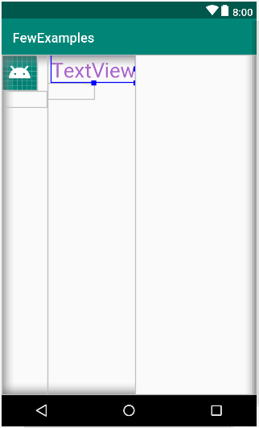
Tùy biến ListView (Web & Location) Thiết kế layout cho ListItem
LinearLayout (horizontal)
LinearLayout (vertical)
ImageView:
android:id="@+id/foodImage" android:layout_width="24pt" android:layout_height="24pt“
TextView:
android:id="@+id/foodLink" android:visibility="invisible"
LinearLayout (vertical)
TextView:
android:id="@+id/foodName" android:textSize="14pt"
TextView:
android:id="@+id/foodLocation" android:visibility="invisible"

Slide 5
Tùy biến ListView (Web & Location)
Tạo adapter quản lý dữ liệu cho ListView
public class CustomListItemAdapter extends ArrayAdapter<ItemsList> { Context context; ItemsList[] items; public CustomListItemAdapter(Context context, int layoutTobeInflated, ItemsList[] items) { super(context, R.layout.list_item_lnk_img, items); this.context = context; this.items = items; }

Slide 6
Tùy biến ListView (Web & Location)
Thay vì tạo riêng từng onClickListener cho từng item, ta tạo biến thành viên kiểu OnClickListener và ấn định cho các TextView hay ImageView trên từng item
private View.OnClickListener itemClickListener = new View.OnClickListener() { @Override public void onClick(View v) { switch (v.getId()) { case R.id.foodName: //TextView fn = (TextView)v; String fl = (String) v.getTag(); Toast.makeText(context, fl.toString(), Toast.LENGTH_SHORT).show(); showView(fl.toString()); return; case R.id.foodImage: ImageView fi = (ImageView) v; String floc = (String) fi.getTag(); Toast.makeText(context, floc.toString(), Toast.LENGTH_SHORT).show(); showView(floc.toString()); return; } } };

Slide 7
Tùy biến ListView (Web & Location) Override getView của adapter để tạo gắn kết dữ liệu
@Override public View getView(int position, View convertView, ViewGroup parent) { LayoutInflater inflater = ((Activity) context).getLayoutInflater(); View row = inflater.inflate(R.layout.list_item_lnk_img, null); TextView foodName = (TextView) row.findViewById(R.id.foodName); ImageView foodImage = (ImageView) row.findViewById(R.id.foodImage); TextView foodLink = (TextView)row.findViewById(R.id.foodLink); TextView foodLocation = (TextView)row.findViewById(R.id.foodLocation); foodName.setText(items[position].getFoodName().toString()); foodLink.setText(items[position].getFoodLink().toString()); foodName.setTag(foodLink.getText().toString()); foodImage.setImageResource(items[position].getFoodImage()); foodLocation.setText(items[position].getFoodLocation().toString()); foodImage.setTag(foodLocation.getText().toString()); foodName.setOnClickListener(itemClickListener); foodImage.setOnClickListener(itemClickListener); return row; }

Slide 8
Tùy biến ListView (Web & Location) MainActivity
ListView lst; ItemsList[] items; CustomListItemAdapter adapter; @Override protected void onCreate(Bundle savedInstanceState) { super.onCreate(savedInstanceState); setContentView(R.layout.activity_tour); prepareData(); adapter = new CustomListItemAdapter(this, R.layout.list_item_lnk_img, items); lst = (ListView)findViewById(R.id.lstTour); lst.setAdapter(adapter); } private void prepareData() { items = new ItemsList[2]; items[0] = new ItemsList("Quán ăn ngon Sài Gòn", "http://www.google.com", R.drawable.food, "geo:0,0?q=14+Đồng+Đen+phường+14+Hồ+Chí+Minh+Bến+Nghé"); items[1] = new ItemsList("Ngon Restaurant", "http://www.google.com", R.drawable.food, "geo:0,0?q=160+Pasteur+Bến+Nghé+Quận+1+Hồ+Chí+Minh"); }

Slide 9
Tùy biến ListView (Web & Location)
private void showView(String v) { Intent intent = new Intent(Intent.ACTION_VIEW, Uri.parse(v)); if (intent.resolveActivity(context.getPackageManager())!=null) context.startActivity(intent); }

